Slide 1
Employee Attrition: An Analysis
Presented by – Group 6
Sachin Santosh Gupta
Aayushi Wani
Pawale Krishna Balwan
Sooraj Sanjai
S Renuka
Kanchan Rai

Slide 2
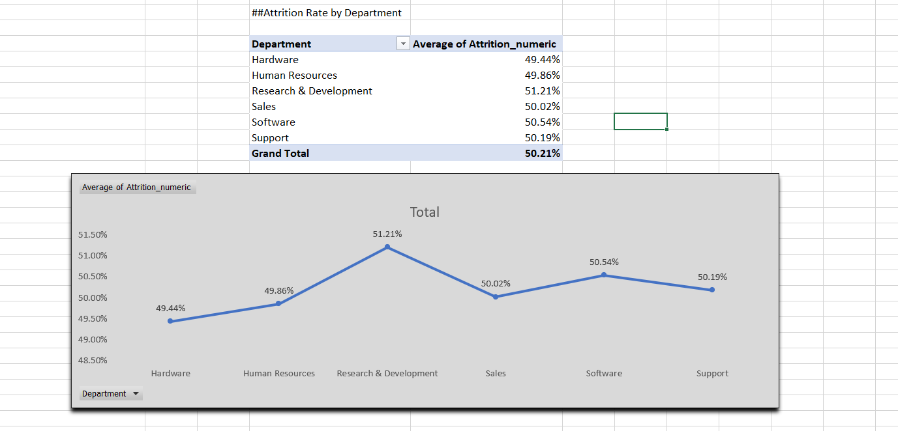
Q 1 Average Attrition rate for all Departments

Slide 3

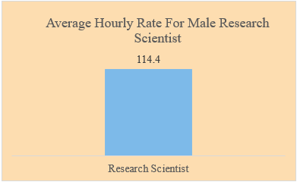
Q 2 Average Hourly Rate of Male Research Scientist

Slide 4

Q 3 Attrition rate Vs Monthly income stats

Slide 5
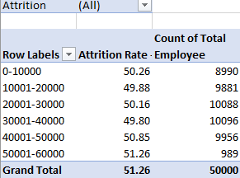
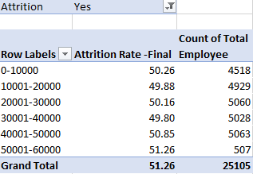
Q 3 Attrition rate Vs Monthly income stats

Slide 6
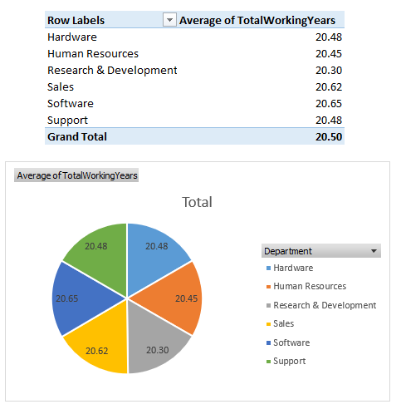
Q 4 - Average working years for each Department

Slide 7
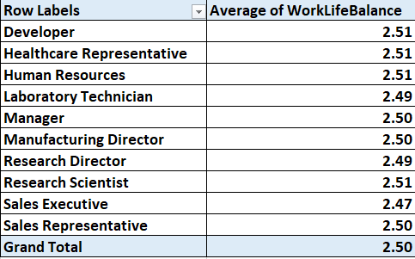
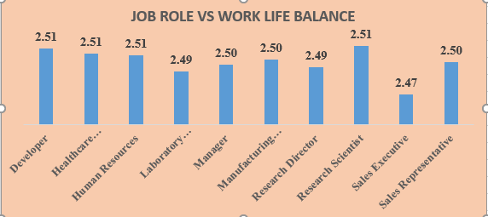
Q 5 - Job Role Vs Work life balance

Slide 8
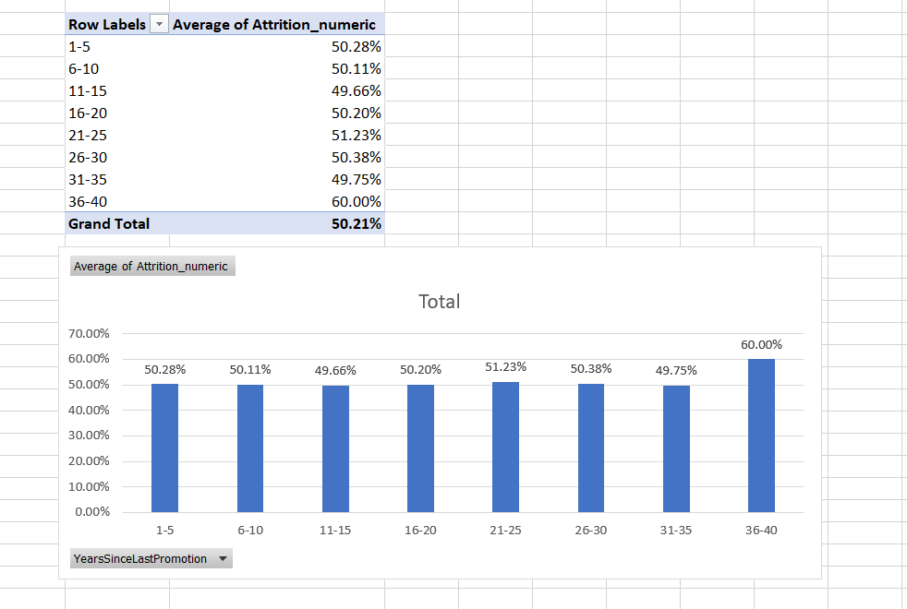
Q 6 - Attrition rate Vs Year since last promotion relation

